Slide 2
http://www.nature.com/scitable/content/the-four-bases-atcg-6491969

Slide 3
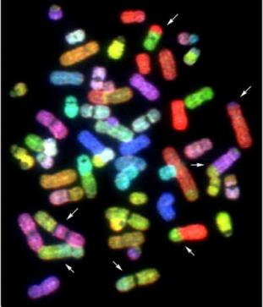
Next Generation Sequencing and Human Genome Databases
Genomics, Bioinformatics & Medicine
http://biochem158.stanford.edu/
Doug Brutlag
Professor Emeritus of Biochemistry & Medicine
Stanford University School of Medicine
Notes:
I have been asked to speak to you about the impact that the human genome project will have on biomedical research and education.
It is clear that the new fields of genomics and bioinformatics will have the same revolutionary effects on medicine as they have had on molecular biology and biomedical research. I would like to present you with a vision of that revolution and some of its implications for medicine and medical education in particular.
I would first like to call your attention to some reference materials that can give you further background on these issues:
Scientifc American Introduction to Molecular Medicine, just enough, BMA.
Science Magazine features the Human Genome project, Lee Rowan (sequencing human genome), Phil Hieter on Understanding the Human genome, Joe Derisi, current graduate students (studying gene expression)
MIS Short Course on Medical Informatics
http://biochem158.stanford.edu/ - you may see a videolectures here

Slide 4

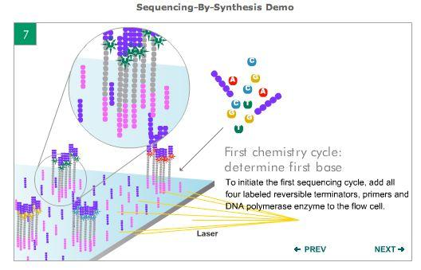
Illumina Solexa Sequencing Technology
Notes:
http://www.illumina.com/
Illumina Solexa Sequencing Technology

Slide 5

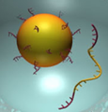

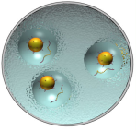
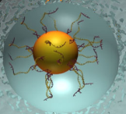

Emulsion Based Clonal Amplification
Single test tube generation of millions of clonally amplified sequencing templates
No cloning and colony picking
A
+ PCR Reagents
B
+ Emulsion Oil
Micro-reactors
Adapter carrying
library DNA
Anneal DNA template
to capture beads
“Water-in-oil”
emulsion
Break micro-reactors
Isolate DNA containing beads
Perform emulsion PCR
Notes:
http://www.my454.com/
Emulsion Based Clonal Amplification

Slide 6


Pacific Biosciences SMRT Sequencing
Notes:
http://www.pacificbiosciences.com/
Pacific Biosciences SMRT Sequencing

Slide 7
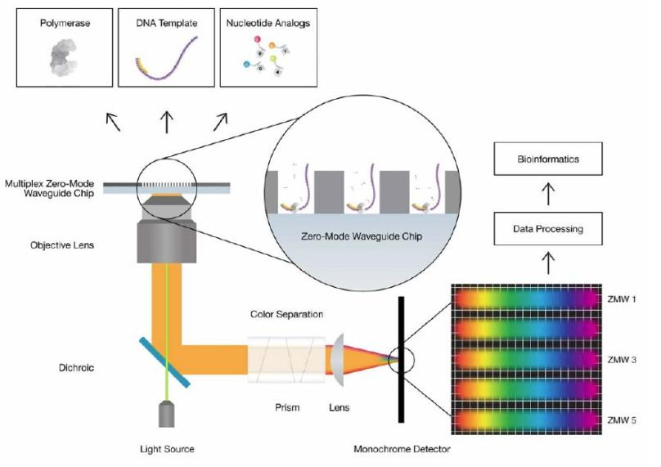
Highly Parallel Optics System
Notes:
http://www.pacificbiosciences.com/

Slide 8
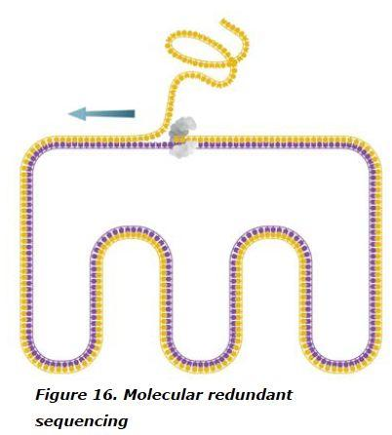
Circular Templates Gives Redundant Sequencing and Accuracy
Notes:
http://www.pacificbiosciences.com/

Slide 9
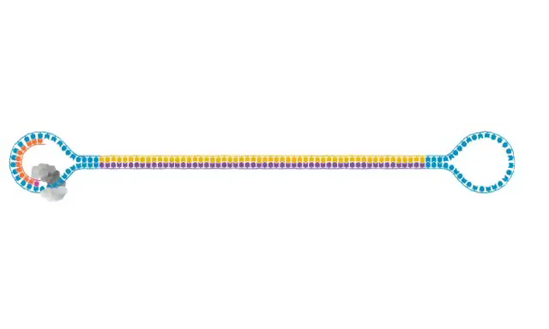
Circular Templates Gives Redundant Sequencing and Accuracy
Notes:
http://www.pacificbiosciences.com/
Circular Templates Gives Redundant Sequencing and Accuracy

Slide 10

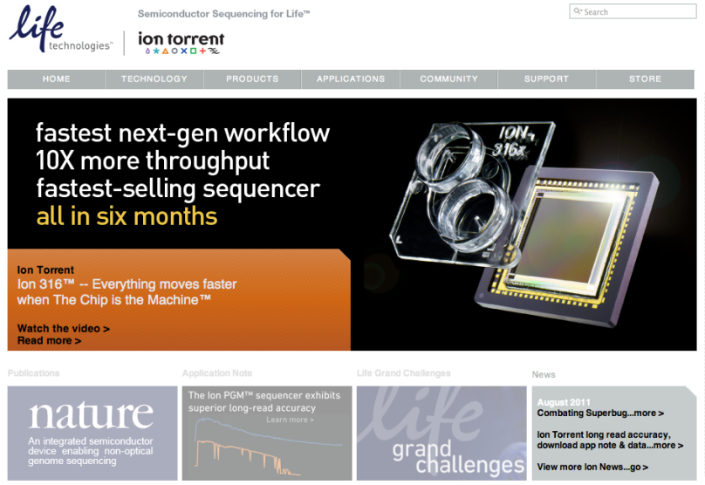
Ion Torrent Sequencing
Notes:
http://www.iontorrent.com/
Ion Torrent Sequencing

Slide 11
Next Generation Sequencing and Human Genome Databases
Genomics, Bioinformatics & Medicine
http://biochem158.stanford.edu/
Doug Brutlag
Professor Emeritus of Biochemistry & Medicine
Stanford University School of Medicine
Notes:
I have been asked to speak to you about the impact that the human genome project will have on biomedical research and education.
It is clear that the new fields of genomics and bioinformatics will have the same revolutionary effects on medicine as they have had on molecular biology and biomedical research. I would like to present you with a vision of that revolution and some of its implications for medicine and medical education in particular.
I would first like to call your attention to some reference materials that can give you further background on these issues:
Scientifc American Introduction to Molecular Medicine, just enough, BMA.
Science Magazine features the Human Genome project, Lee Rowan (sequencing human genome), Phil Hieter on Understanding the Human genome, Joe Derisi, current graduate students (studying gene expression)
MIS Short Course on Medical Informatics
http://biochem158.stanford.edu/ - you may see a videolectures here

Slide 12
Illumina Solexa Sequencing Technology
Notes:
http://www.illumina.com/
Illumina Solexa Sequencing Technology

Slide 13
Emulsion Based Clonal Amplification
Single test tube generation of millions of clonally amplified sequencing templates
No cloning and colony picking
A
+ PCR Reagents
B
+ Emulsion Oil
Micro-reactors
Adapter carrying
library DNA
Anneal DNA template
to capture beads
“Water-in-oil”
emulsion
Break micro-reactors
Isolate DNA containing beads
Perform emulsion PCR
Notes:
http://www.my454.com/
Emulsion Based Clonal Amplification

Slide 14
Pacific Biosciences SMRT Sequencing
Notes:
http://www.pacificbiosciences.com/
Pacific Biosciences SMRT Sequencing

Slide 15
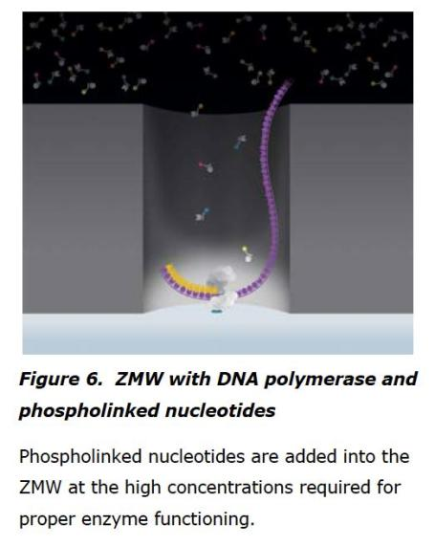
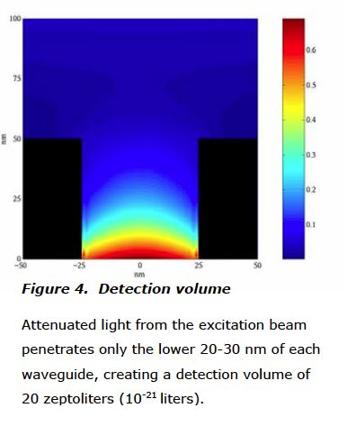
Pacific Biosciences Sequencing
Notes:
http://www.pacificbiosciences.com/

Slide 16
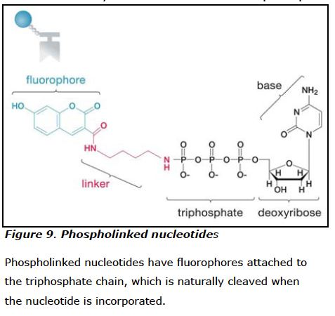
Phospholinked Fluorophores
Notes:
http://www.pacificbiosciences.com/

Slide 17
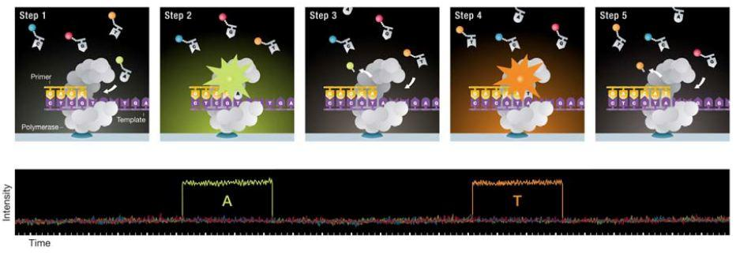
Processive Synthesis
Notes:
http://www.pacificbiosciences.com/

Slide 18
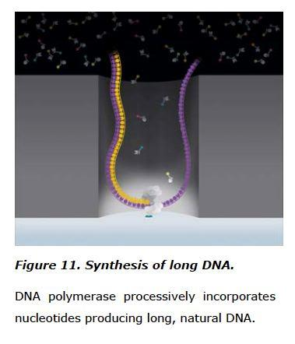
Synthesis of Long Duplex DNA
Notes:
http://www.pacificbiosciences.com/

Slide 19
Highly Parallel Optics System
Notes:
http://www.pacificbiosciences.com/

Slide 20
Circular Templates Gives Redundant Sequencing and Accuracy
Notes:
http://www.pacificbiosciences.com/

Slide 21
Circular Templates Gives Redundant Sequencing and Accuracy
Notes:
http://www.pacificbiosciences.com/
Circular Templates Gives Redundant Sequencing and Accuracy

Slide 22
Ion Torrent Sequencing
Notes:
http://www.iontorrent.com/
Ion Torrent Sequencing

Slide 23
Ion Torrent Sequencing
Notes:
http://www.iontorrent.com/
Ion Torrent Sequencing

Slide 24
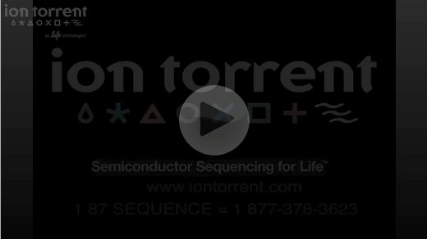
Ion Torrent Sequencing
Notes:
http://www.iontorrent.com/
Ion Torrent Sequencing

Slide 25
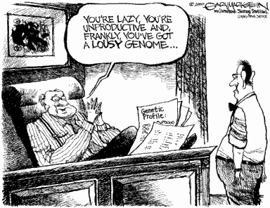
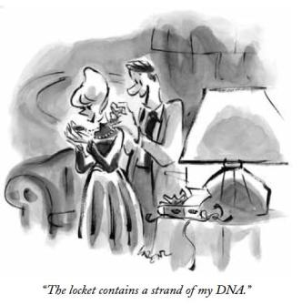
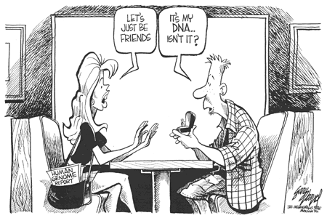
The Human Genome How fast is the cost going down?
2006: $ 50 million
2008: $500,000
2009: $50,000
2010: $20,000
2011: $5,000
2012:??? $1,000
Thanks to Serafim Batzoglou

Slide 26

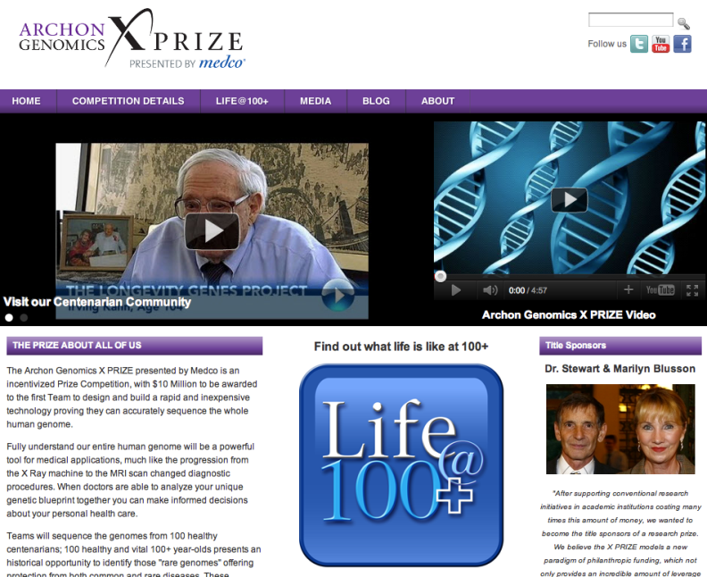
Archon Genomics X-Prize
Notes:
http://genomics.xprize.org/

Slide 27
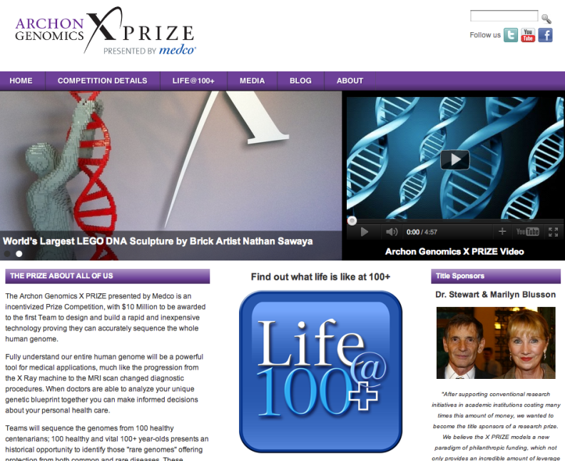
Archon Genomics X-Prize
Notes:
http://genomics.xprize.org/

Slide 28
Active Genes are Transcribed into RNA
Promoter
Exon
Intron
Exon
Intron
Exon
Terminator
Gene
Primary
Transcript

Slide 29
Splicing Transcript Yields Mature mRNA
Promoter
Exon
Intron
Exon
Intron
Exon
Terminator
Gene
Transcript
Splicing
3’
mRNA
5’

Slide 30

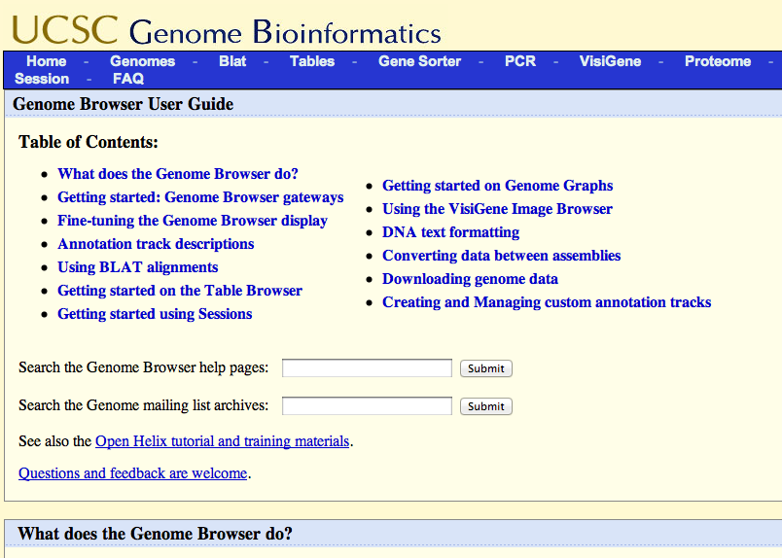
UCSC Help File http://genome.ucsc.edu/goldenPath/help/hgTracksHelp.html
Notes:
http://genome.ucsc.edu/goldenPath/help/hgTracksHelp.html

Slide 31
Introduction
The impending collapse of the genome informatics
Major sequence-data relateddatabases: GenBank, EMBL, DDBJ, SRA, GEO, and ArrayExpress
Value-added integrators of genomic data: Ensembl, UCSC Genome Browser, Galaxy, and many model organism databases.

Slide 33
Basis for the production and consumption of genomic information
Moore's Law: “the number of transistors that can be placed on an integrated circuit board is increasing exponentially, with a doubling time of roughly 18 months.”
Similar laws for disk storage and network capacity have also been observed.
Until now the doubling time for DNA sequencing was just a bit slower than the growth of compute and storage capacity.

Slide 35
Current Situation
Soon it will cost less to sequence a base of DNA than to store it on hard disk
We are facing potential tsunami of genome data that will swamp our storage system and crush our compute clusters
Who is affected:
Genome sequence repositories who need maintain and timely update their data
“Power users” who accustomed to download the data to local computer for analysis

Slide 36
Cloud Computing
Cloud computing is a general term for computation-as-a-service
Computation-as-a-service means that customers rent the hardware and the storage only for the time needed to achieve their goals
In cloud computing the rentals are virtual
The service provider implements the infrastructure to give users the ability to create, upload, and launch virtual machines on their extremely large and powerful compute farm.

Slide 37
Virtual Machine
Virtual machine is software that emulates the properties of a computer.
Any operating system can be chosen to run on the virtual machine and all the tasks we usually perform on the computer can be performed on virtual machine.
Virtual machine bootable disk can be stored as an image. This image can used as a template to start up multiple virtual machines – launching a virtual compute cluster is very easy.
Storing large data sets is usually done with virtual disks. Virtual disk image can be attached to virtual machine as local or shared hard drive.

Slide 39
Cloud computing service providers and their offered services
Some of the cloud computing service providers are: Amazon (Elastic Cloud Computing), Rackspace Cloud, Flexiant.
Amazon offers a variety of bioinformatics-oriented virtual machine images:
Images prepopulated by Galaxy
Bioconductor – programming environment with R statistic package
GBrowser – genome browser
BioPerl
JCVI Cloud BioLinux – collection of bioinformatics tools including Celera Assembler
Amazon also provides several large genomic datasets in its cloud:
Complete copy of GeneBank (200 Gb)
30x coverage sequencing reads of a trio of individuals from 1000 Genome Project (700Gb)
Genome databases from Ensembl including annotated human and 50 other species genomes

Slide 41
Academic cloud computing
Growing number of academic compute cloud projects are based on open source cloud management software.
Open Cloud Consortium is an example of one such project

Slide 42
Cloud computing disadvantages
Cost of migrating existing systems into the new and unfamiliar environment
Security and privacy of the data
Need additional level of data encryption
Need new software that will restrict access to only authorized users
Major question: does cloud computing make economic sense?

Slide 43
Comparing relative costs of renting vs. buying computational services
According to technical report on Cloud Computing by UC Berkeley Reliable Adaptive Distributed Systems Laboratory
When all the costs of maintaining a large compute cluster are considered the cost of renting a data center from Amazon is marginally more expensive than buying one.
When the flexibility of the cloud to support a virtual data center that downsizes or grows as needed is factored in, the economics start to look better

Slide 44
Obstacles in moving toward cloud computing for genomics
Network bandwidth – transferring 100 gigabit next-generation sequencing data file across 10Gb/sec connection will take less than a day only if hogging much of the institution’s bandwidth.
Cloud computing service providers will have to offer some flexibility in how large datasets get into system.

Slide 45
Cloud Technologies for Bioinformatics Applications
By Jaliya Ekanayake, Thilina Gunarathne, and Judy Qui
IEEE transactions on parallel and distributed systems

Slide 46
Motivation for presenting the article
Exponential increase in the size of datasets implies that parallelism is essential to process the information in a timely fashion.
The algorithms presented in this paper might reduce computational analysis time significantly whether used on our own cluster or on rented Amazon virtual cluster.
This paper presents a nice example of how these new parallel computing algorithms can be applied for bioinformatics

Slide 47
MapReduce
MapReduce is a software framework introduced by Google to support distributed computing on large data sets on computer clusters.
Users specify a map function that processes a key/value pair to generate a set of intermediate key/value pairs, and a reduce function that merges all intermediate values associated with the same intermediate key.
Programs written in this functional style are automatically parallelized and executed on a large cluster of commodity machines. The run-time system takes care of the details of partitioning the input data, scheduling the program's execution across a set of machines, handling machine failures, and managing the required inter-machine communication. This allows programmers without any experience with parallel and distributed systems to easily utilize the resources of a large distributed system.

Slide 48
Tow steps of MapReduce
Map: The master node takes the input, chops it up into smaller sub-problems, and distributes those to worker nodes. The worker node processes that smaller problem, and passes the answer back to its master node.
Reduce: The master node then takes the answers to all the sub-problems and combines them in a way to get the output - the answer to the problem it was originally trying to solve.

Slide 50
Objectives
Examine 3 technologies:
Microsoft Drayd/DryadLINQ
Apache Hadoop
Message Passing Interface (MPI)
These 3 technologies are applied to 2 bioinformatics applications:
Expressed Sequence Tags (EST)
Alu clustering

Slide 51
Technolgies
MPI – The goal of MPI is to provide a widely used standard for writing message passing programs. MPI is used in distributed and parallel computing.
Dryad/DryadLINQ is a distributed execution engine for coarse grain data parallel applications. It combines the MapReduce programming style with dataflow graphs to solve computational problems.
Apache Hadoop is an open source Java implementation of MapReduce. Hadoop schedules the MapReduce computation tasks depending on the data locality.

Slide 52
Bioinformatics applications
Alu Sequence Classification is one of the most challenging problems for sequence clustering because Alus represent the largest repeat families in human genome. For the specific objectives of the paper an open source version of the Smith Waterman – Gotoh (SW-G) algorithm was used.
EST (Expressed Sequence Tag) corresponds to messenger RNAs transcribed from genes residing on chromosomes. Each individual EST sequence represents a fragment of mRNA, and the EST assembly aims to reconstruct full-length mRNA sequence for each expressed gene. Specific implementation used for this research is CAP3 software.

